Slide 1

Data Manipulation Language
Database Management Systems

Slide 2
INSERT, UPDATE, DELETE
INSERT - add a row to a table
UPDATE - change row(s) in a table
DELETE - remove row(s) from a table
UPDATE and DELETE use ‘WHERE clauses’ to specify which rows to change or remove
BE CAREFUL with these - an incorrect WHERE clause can destroy lots of data
More SQL Data Definition

Slide 3
INSERT
INSERT INTO
<table>
(col1, col2, …)
VALUES
(val1, val2, …)
  The number of columns and values must be the same
  If you are adding a value to every column, you don’t have to list them
  SQL doesn’t require that all rows are different (unless a constraint says so)
More SQL Data Definition

Slide 4
INSERT
Student
INSERT INTO Student
(ID, Name, Year)
VALUES (2, ‘Mary’, 3)
ID
1
2
Name
John
Mary
Year
1
3
Student
Student
INSERT INTO Student
(Name, ID)
VALUES (‘Mary’, 2)
ID
1
2
Name
John
Mary
Year
1
ID
1
Name
John
Year
1
Student
INSERT INTO Student
VALUES (2, ‘Mary’, 3)
ID
1
2
Name
John
Mary
Year
1
3
More SQL Data Definition

Slide 5
UPDATE
UPDATE <table>
SET col1 = val1
[,col2 = val2…]
[WHERE
<condition>]
  All rows where the condition is true have the columns set to the given values
  If no condition is given all rows are changed so BE CAREFUL
  Values are constants or can be computed from columns
More SQL Data Definition

Slide 6
UPDATE
Student
ID
1
2
3
4
Name
John
Mark
Anne
Jane
Year
1
3
2
1
UPDATE Student
SET Year = 1,
Name = ‘Jane’
WHERE ID = 4
Student
ID
1
2
3
4
Name
John
Mark
Anne
Mary
Year
1
3
2
2
Student
ID
1
2
3
4
Name
John
Mark
Anne
Mary
Year
2
4
3
3
UPDATE Student
SET Year = Year + 1
More SQL Data Definition

Slide 7
DELETE
Removes all rows which satisfy the condition
DELETE FROM
<table>
[WHERE
<condition>]
  If no condition is given then ALL rows are deleted - BE CAREFUL
  Some versions of SQL also have TRUNCATE TABLE <T> which is like DELETE FROM <T> but it is quicker as it doesn’t record its actions
More SQL Data Definition

Slide 8
DELETE
Student
DELETE FROM
Student
WHERE Year = 2
ID
1
2
Name
John
Mark
Year
1
3
Student
ID
1
2
3
4
Name
John
Mark
Anne
Mary
Year
1
3
2
2
Student
DELETE FROM Student
or
TRUNCATE TABLE Student
ID
Name
Year
More SQL Data Definition

Slide 9
SELECT
The SQL command you will use most often
  Queries a set of tables and returns results as a table
  Lots of options, we will look at many of them
  Usually more than one way to do any given query
SQL’s SELECT is different from the relational algebra’s selection σ
  SELECT in SQL does all of the relational algebra
  But it is a bit different because SQL differs from the relational model
More SQL Data Definition

Slide 10
SQL SELECT Overview
SELECT
[DISTINCT | ALL] <column-list>
FROM <table-names>
[WHERE <condition>]
[ORDER BY <column-list>]
[GROUP BY <column-list>]
[HAVING <condition>]
([]- optional, | - or)
More SQL Data Definition

Slide 11
Simple SELECT
SELECT <columns>
FROM <table>
<columns> can be
  A single column
  A comma-separated list of columns
  * for ‘all columns’
Given a table Student with columns
  stuID
  stuName
  stuAddress
  stuYear
More SQL Data Definition

Slide 12
Sample SELECTs
SELECT * FROM Student
stuID | stuName | stuAddress | stuYear
1 | Anderson | 15 High St | 1
2 | Brooks | 27 Queen’s Rd | 3
3 | Chen | Lenton Hall | 1
4 | D’Angelo | Derby Hall | 1
5 | Evans | Lenton Hall | 2
6 | Franklin | 13 Elm St | 3
7 | Gandhi | Lenton Hall | 1
8 | Harrison | Derby Hall | 1
More SQL Data Definition

Slide 13
Sample SELECTs
SELECT stuName FROM Student
stuName
Anderson
Brooks
Chen
D’Angelo
Evans
Franklin
Gandhi
Harrison
More SQL Data Definition

Slide 14
Sample SELECTs
SELECT stuName, stuAddress
FROM Student
stuName | stuAddress
Anderson | 15 High St
Brooks | 27 Queen’s Rd
Chen | Lenton Hall
D’Angelo | Derby Hall
Evans | Lenton Hall
Franklin | 13 Elm St
Gandhi | Lenton Hall
Harrison | Derby Hall
More SQL Data Definition

Slide 15
Being Careful
When using DELETE and UPDATE
  You need to be careful to have the right WHERE clause
  You can check it by running a SELECT statement with the same WHERE clause first
Before running
DELETE FROM Student
WHERE Year = 3
run
SELECT * FROM Student
WHERE Year = 3
More SQL Data Definition

Slide 16
The AND Operator
The AND operator allows the existence of multiple conditions in an SQL statement's WHERE clause.
Syntax
The basic syntax of the AND operator with a WHERE clause is as follows
SELECT column1, column2, columnN FROM table_name WHERE [condition1] AND [condition2]...AND [conditionN];
SQL> SELECT ID, NAME, SALARY FROM CUSTOMERS WHERE SALARY > 2000 AND age < 25;
More SQL Data Definition

Slide 17
The OR Operator
The OR operator is used to combine multiple conditions in an SQL statement's WHERE clause.
Syntax
The basic syntax of the OR operator with a WHERE clause is as follows −
SELECT column1, column2, columnN FROM table_name WHERE [condition1] OR [condition2]...OR [conditionN]
SQL> SELECT ID, NAME, SALARY FROM CUSTOMERS WHERE SALARY > 2000 OR age < 25;
More SQL Data Definition

Slide 18
The SQL LIKE clause is used to compare a value to similar values using wildcard operators. There are two wildcards used in conjunction with the LIKE operator.
The percent sign (%)
The underscore (_)
The percent sign represents zero, one or multiple characters.
The underscore represents a single number or character. These symbols can be used in combinations.
The basic syntax of % and _ is as follows −
SELECT FROM table_name WHERE column LIKE 'XXXX%' or SELECT FROM table_name WHERE column LIKE '%XXXX%'
More SQL Data Definition

Slide 19
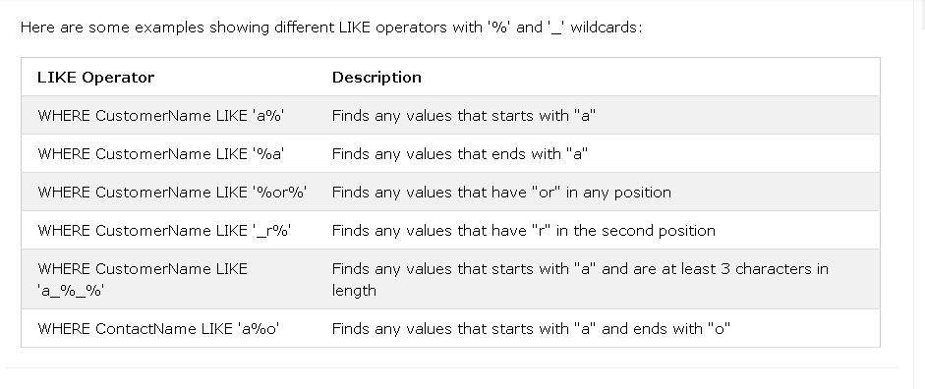
More SQL Data Definition

Slide 20
1 WHERE SALARY LIKE '200%'
Finds any values that start with 200.
2 WHERE SALARY LIKE '%200%'
Finds any values that have 200 in any position.
3 WHERE SALARY LIKE '_00%'
Finds any values that have 00 in the second and third positions.
4 WHERE SALARY LIKE '2_%_%'
Finds any values that start with 2 and are at least 3 characters in length.
WHERE SALARY LIKE '%2‘
Finds any values that end with 2.
More SQL Data Definition

Slide 21
the SQL ORDER BY clause is used to sort the data in ascending or descending order, based on one or more columns. Some databases sort the query results in an ascending order by default.
The basic syntax of the ORDER BY clause is as follows −
SELECT column-list FROM table_name [WHERE condition] [ORDER BY column1, column2, .. columnN] [ASC | DESC];
SQL> SELECT * FROM CUSTOMERS ORDER BY NAME, SALARY;
SQL> SELECT * FROM CUSTOMERS ORDER BY NAME DESC;
More SQL Data Definition

Slide 22
The SQL GROUP BY clause is used in collaboration with the SELECT statement to arrange identical data into groups. This GROUP BY clause follows the WHERE clause in a SELECT statement and precedes the ORDER BY clause.
The basic syntax of a GROUP BY clause is shown in the following code block. The GROUP BY clause must follow the conditions in the WHERE clause and must precede the ORDER BY clause if one is used.
SELECT column1, column2 FROM table_name WHERE [ conditions ] GROUP BY column1, column2 ORDER BY column1, column2
More SQL Data Definition

Slide 23
Example
Consider the CUSTOMERS table is having the following records −-
| ID | NAME | AGE | ADDRESS | SALARY |
| 1 | Ramesh | 32 | Ahmedabad | 2000.00 |
| 2 | Khilan | 25 | Delhi | 1500.00 |
| 3 | kaushik | 23 | Kota | 2000.00 |
| 4 | Chaitali | 25 | Mumbai | 6500.00 |
| 5 | Hardik | 27 | Bhopal | 8500.00 |
| 6 | Komal | 22 | MP | 4500.00 |
| 7 | Muffy | 24 | Indore | 10000.00 |
- If you want to know the total amount of the salary on each customer, then the GROUP BY query would be as follows.
SQL> SELECT NAME, SUM(SALARY) FROM CUSTOMERS GROUP BY NAME;
More SQL Data Definition

Slide 24
This would produce the following result −
+----------+-------------+
| NAME | SUM(SALARY) |
+----------+-------------+
| Chaitali | 6500.00 |
| Hardik | 8500.00 |
| kaushik | 2000.00 |
| Khilan | 1500.00 |
| Komal | 4500.00 |
| Muffy | 10000.00 |
| Ramesh | 2000.00 |
+----------+-------------+
More SQL Data Definition

Slide 25
Now, let us look at a table where the CUSTOMERS table has the following records with duplicate names −
+----+----------+-----+-----------+----------+
| ID | NAME | AGE | ADDRESS | SALARY |
+----+----------+-----+-----------+----------+
| 1 | Ramesh | 32 | Ahmedabad | 2000.00 |
| 2 | Ramesh | 25 | Delhi | 1500.00 |
| 3 | kaushik | 23 | Kota | 2000.00 |
| 4 | kaushik | 25 | Mumbai | 6500.00 |
| 5 | Hardik | 27 | Bhopal | 8500.00 |
| 6 | Komal | 22 | MP | 4500.00 |
| 7 | Muffy | 24 | Indore | 10000.00 |
+----+----------+-----+-----------+----------+
More SQL Data Definition

Slide 26
Now again, if you want to know the total amount of salary on each customer, then the GROUP BY query would be as follows −
SQL> SELECT NAME, SUM(SALARY) FROM CUSTOMERS GROUP BY NAME;
This would produce the following result −
+---------+-------------+
| NAME | SUM(SALARY) |
+---------+-------------+
| Hardik | 8500.00 |
| kaushik | 8500.00 |
| Komal | 4500.00 |
| Muffy | 10000.00 |
| Ramesh | 3500.00 |
+---------+-------------+
More SQL Data Definition

Slide 27
The HAVING Clause enables you to specify conditions that filter which group results appear in the results.
The WHERE clause places conditions on the selected columns, whereas the HAVING clause places conditions on groups created by the GROUP BY clause.
The following code block shows the position of the HAVING Clause in a query.
SELECT FROM WHERE GROUP BY HAVING ORDER BY The HAVING clause must follow the GROUP BY clause in a query and must also precede the ORDER BY clause if used. The following code block has the syntax of the SELECT statement including the HAVING clause −
SELECT column1, column2 FROM table1, table2 WHERE [ conditions ] GROUP BY column1, column2 HAVING [ conditions ] ORDER BY column1, column2
More SQL Data Definition

Slide 28
Example
Consider the CUSTOMERS table having the following records.
+----+----------+-----+-----------+----------+
| ID | NAME | AGE | ADDRESS | SALARY |
+----+----------+-----+-----------+----------+
| 1 | Ramesh | 32 | Ahmedabad | 2000.00 |
| 2 | Khilan | 25 | Delhi | 1500.00 |
| 3 | kaushik | 23 | Kota | 2000.00 |
| 4 | Chaitali | 25 | Mumbai | 6500.00 |
| 5 | Hardik | 27 | Bhopal | 8500.00 |
| 6 | Komal | 22 | MP | 4500.00 |
| 7 | Muffy | 24 | Indore | 10000.00 |
+----+----------+-----+-----------+----------+
Following is an example, which would display a record for a similar age count that would be more than or equal to 2.
More SQL Data Definition

Slide 29
SQL > SELECT ID, NAME, AGE, ADDRESS, SALARY FROM CUSTOMERS GROUP BY age HAVING COUNT(age) >= 2;
This would produce the following result −
+----+--------+-----+---------+---------+
| ID | NAME | AGE | ADDRESS | SALARY |
+----+--------+-----+---------+---------+
| 2 | Khilan | 25 | Delhi | 1500.00 |
+----+--------+-----+---------+---------+
More SQL Data Definition

Slide 30
SQL AGGREGATE FUNCTIONS
In database management an aggregate function is a function where the values of multiple rows are grouped together as input on certain criteria to form a single value of more significant meaning.
Various Aggregate Functions
1) Count()
2) Sum()
3) Avg()
4) Min()
5) Max()
More SQL Data Definition

Slide 31
SQL AGGREGATE FUNCTIONS
Id Name Salary
1 A 80
2 B 40
3 C 60
4 D 70
5 E 60
6 F Null
Count():
Count(*): Returns total number of records .i.e 6.
Count(salary): Return number of Non Null values over the column salary. i.e 5.
Count(Distinct Salary): Return number of distinct Non Null values over the column salary .i.e 4
More SQL Data Definition

Slide 32
SQL AGGREGATE FUNCTIONS
Sum():
sum(salary): Sum all Non Null values of Column salary i.e., 310
sum(Distinct salary): Sum of all distinct Non-Null values i.e., 250.
Avg():
Avg(salary) = Sum(salary) / count(salary) = 310/5
Avg(Distinct salary) = sum(Distinct salary) / Count(Distinct Salary) = 250/4
More SQL Data Definition

Slide 33
SQL AGGREGATE FUNCTIONS
MIN() and MAX() Functions
The MIN() function returns the smallest value of the selected column.
MIN() Syntax
SELECT MIN(column_name)
FROM table_name
WHERE condition;
The MAX() function returns the largest value of the selected column.
MAX() Syntax
SELECT MAX(column_name)
FROM table_name
WHERE condition;
More SQL Data Definition

Slide 34
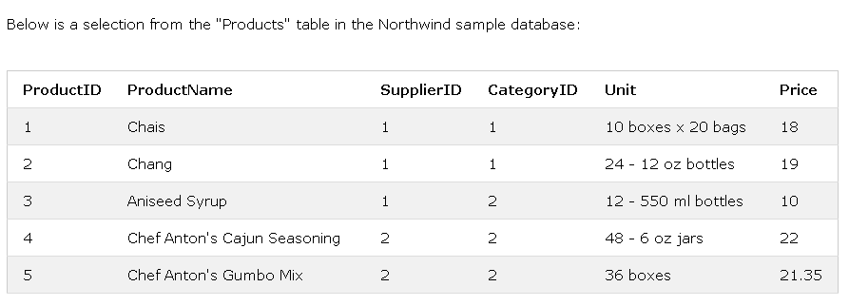
MIN() Example
The following SQL statement finds the price of the cheapest product:
Example
SELECT MIN(Price) AS SmallestPrice
FROM Products;
More SQL Data Definition

Slide 35
SmallestPrice
2.5
MAX() Example
The following SQL statement finds the price of the most expensive product:
Example
SELECT MAX(Price) AS LargestPrice
FROM Products;
More SQL Data Definition

Slide 36
SQL FOREIGN KEY Constraint
A FOREIGN KEY is a key used to link two tables together.
A FOREIGN KEY is a field (or collection of fields) in one table that refers to the PRIMARY KEY in another table.
The table containing the foreign key is called the child table, and the table containing the candidate key is called the referenced or parent table.
More SQL Data Definition

Slide 37
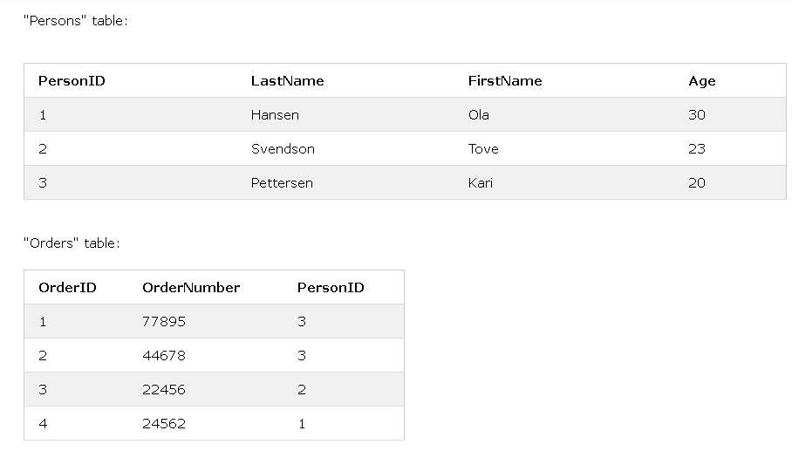
Notice that the "PersonID" column in the "Orders" table points to the "PersonID" column in the "Persons" table.
The "PersonID" column in the "Persons" table is the PRIMARY KEY in the "Persons" table.
The "PersonID" column in the "Orders" table is a FOREIGN KEY in the "Orders" table.
The FOREIGN KEY constraint is used to prevent actions that would destroy links between tables.
The FOREIGN KEY constraint also prevents invalid data from being inserted into the foreign key column, because it has to be one of the values contained in the table it points to.
More SQL Data Definition

Slide 38
Notice that the "PersonID" column in the "Orders" table points to the "PersonID" column in the "Persons" table.
The "PersonID" column in the "Persons" table is the PRIMARY KEY in the "Persons" table.
The "PersonID" column in the "Orders" table is a FOREIGN KEY in the "Orders" table.
The FOREIGN KEY constraint is used to prevent actions that would destroy links between tables
.
The FOREIGN KEY constraint also prevents invalid data from being inserted into the foreign key column, because it has to be one of the values contained in the table it points to.
More SQL Data Definition

Slide 39
To allow naming of a FOREIGN KEY constraint, and for defining a FOREIGN KEY constraint on multiple columns, use the following SQL syntax:
CREATE TABLE Orders (
OrderID int NOT NULL,
OrderNumber int NOT NULL,
PersonID int,
PRIMARY KEY (OrderID),
CONSTRAINT FK_PersonOrder FOREIGN KEY (PersonID)
REFERENCES Persons(PersonID)
);
More SQL Data Definition

Slide 40
Foreign keys provide a method for maintaining integrity in the data
Called referential integrity.
Foreign keys values should always be matched by corresponding primary key values.
More SQL Data Definition

Slide 41
COMPARISON OPERATOR
between
create table employee1(fname varchar2(10),lname varchar2(10),
empid number(10),loc varchar2(10),salary number(10));
insert into employee1 values('Ram','Sinha',1,'ldh',23400);
insert into employee1 values('Sham','Sinha',2,'chd',26400);
insert into employee1 values('Sham','Sinha',3,'chd',26400);
insert into employee1 values('Sham','Sinha',4,'chd',26400);
select fname,lname from employee1 where salary between 20000 AND 25000;
More SQL Data Definition

Slide 42
IN
Select * from employee1 where empid IN (2,3,4);
NOT IN
select * from employee1 where empid NOT IN(2,4);
More SQL Data Definition

Slide 43
SET Operations in SQL
SET operators can be used to select data from multiple tables.
SET operators basically combine the result of two queries into one. These queries are known as compound queries.
we will cover 4 different types of SET operations, along with example:
UNION : Returns all unique rows selected by either query
UNION ALL : Returns all rows, including duplicates selected by either query
INTERSECT : Returns rows selected from both queries
MINUS: Returns unique rows selected by the first query but not the rows selected by the second query
More SQL Data Definition

